Slide 1
Database System
Nasreen akhtar
FAST-NU
Chiniot-Faisalabad campus

Slide 2
Week 3
Relational Data Model.
Relational Database Constraints.
Relational Data Model Constraints.
Relational Data base Schema

Slide 3
Relational data model
The relational model represents the database as a collection of relations.
The model was first proposed by Dr. E.F. Codd of IBM in 1970 in the following paper: "A Relational Model for Large Shared Data Banks," Communications of the ACM, June1970.

Slide 4
Relational data model
Terminologies:
A relation is a table with columns and rows.
Attribute is a named column of a relation.
Domain is a set of allowable values for one or more attributes.
Tuple is a row of a relation.
Degree is a number of attributes in a relation.
Cardinality is a number of tuples/records in a relation.
Relational database is a collection of relations.

Slide 5
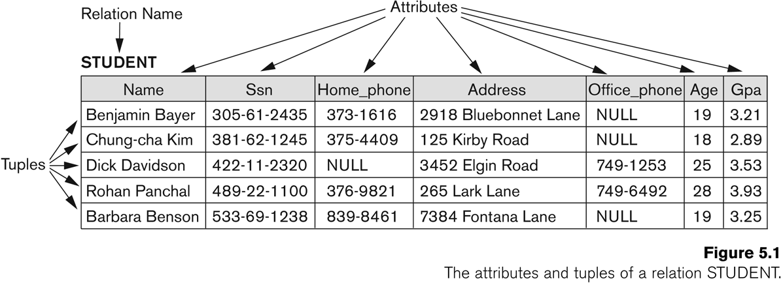
Example of Relation

Slide 6
Relational database
Key of a Relation:
Each row has a value of a data item (or set of items) that uniquely identifies that row in the table
Called the key
In the STUDENT table, SSN is the key

Slide 7
Relational Database Schema
Relational Database Schema:
A set S of relation schemas that belong to the same database.
S is the name of the whole database schema
S = {R1, R2, ..., Rn}
R1, R2, …, Rn are the names of the individual relation schemas within the database S
Following slide shows a COMPANY database schema with 6 relation schemas

Slide 8
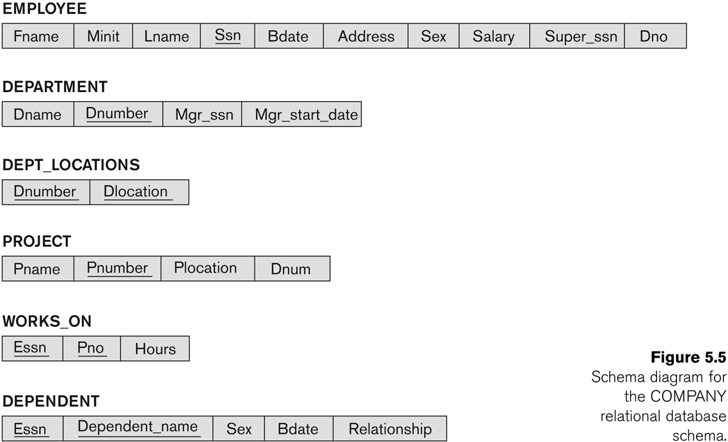
Relational Database Schema

Slide 9
Schema of Relational database
The Schema (or description) of a Relation:
Denoted by R(A1, A2, .....An)
R is the name of the relation
The attributes of the relation are A1, A2, ..., An
The relation state r(R) refers to the present set of data/tuples in the relation.
Example:
CUSTOMER (Cust-id, Cust-name, Address, Phone#)
CUSTOMER is the relation name
Defined over the four attributes: Cust-id, Cust-name, Address, Phone#
Each attribute has a domain or a set of valid values.
For example, the domain of Cust-id is numbers.
A CUSTOMER state may include 100 CUSTOMERS; another 250 CUSTOMERs

Slide 10
Schema of Relational database
All tuples in a relation state r(R) form a set.
By definition, there cannot be duplicates, or identical tuples, in a set.
By definition, set elements (tuples) are not ordered, even though tuples frequently appear to be in the tabular form.
Ordering of attributes however is important
We will consider the attributes in R(A1, A2, ..., An) and the values in t=<v1, v2, ..., vn> to be ordered .

Slide 11
Characteristic of Relations
Each relation in the same relational database schema has a distinct name
Each value in a tuple is 1. atomic 2. No Composite or multi valued attribute
A special null value is used to represent values that are not available. 2 reasons in reality:
Unknown
Inapplicable

Slide 12
Characteristic of Relations
Each attribute in a relation has a distinct name.
Values of an attribute are all from the same domain.
Each tuple is distinct.
Order of attributes has no significance.
Order of tuples has no significance, theoretically.

Slide 13
Keys
A key is a combination of one or more columns that is used to identify rows in a relation
Types are
Primary key
Composite Key
Candidate key
Foreign key
Secondary key
Surrogate key
Super key

Slide 14
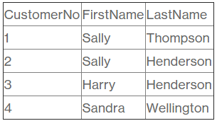
Keys
A Primary Key is a key that uniquely identify record in relation.
it has two characteristics 1. Unique 2. Not Null
There is one and only one primary key per relation
The primary key is unique and not null.
The ideal primary key is short, numeric(alpha), fixed length and never changes
The primary key may be a composite key.

Slide 15
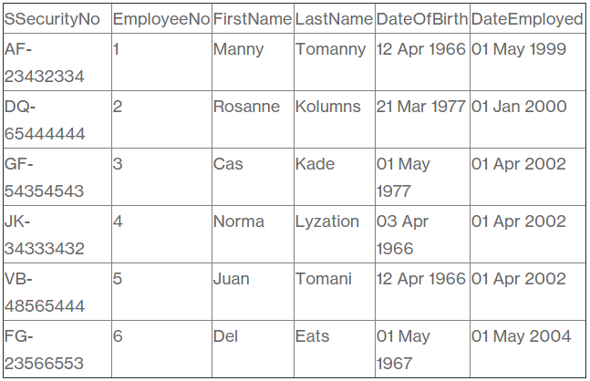
Primary Key

Slide 16
Primary Key

Slide 17
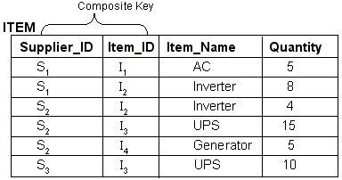
Keys
A composite key is a key that consists of two or more columns.

Slide 18
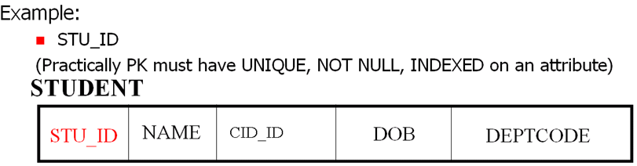
Keys
Although, candidate keys are STU_ID, CIT_ID. Organization ITSELF issues its own identifier PK. PK is a property of an organization. Driving license# is a property of Ministry of Motors/ transportation, it must not be used PK in university or other organizations. It is a candidate key for other organization for search purposes.
Note: It is not recommended to create PKs for columns like Quantity, Salary, Price and column that has datatype DATE

Slide 19
Keys
Example-1:
STUDENT(StuID, FirstName, FamilyName, DOB, …)
Example-2: Building (B#, BName, Location, Region),
B# is a primary key. Although, BName is unique, not null but it is not short.
Example-3: Customer (cname, citizenid, address, city, telno)
This relation indicates the information about personal details. There is a chance that cname is duplicated, some may have citizenid and telno as null. This forces us to introduce new a attribute such as cust# that would be a primary key.
Customer (cust#, cname, citizenid, address, city, telno)

Slide 20
Keys
Candidate Key
A candidate key is a column, or set of columns, in a table that can uniquely identify any database record without referring to any other data
Each table may have one or more candidate keys, but one candidate key is unique, and it is called the primary key
This is usually the best among the candidate keys to use for identification.
Candidate Keys
AccountNo | Name | Address | ContactNo | Cnic | Amount

Slide 21
Surrogate Key
A surrogate key as an artificial column added to a relation to serve as a primary key:
It does not have contextual or business meaning.
Oracle uses SEQUENCE, MySQL uses AUTO_INCREMENT and SQL server uses IDENTITY to generate surrogate key. DBMS supplied
Short, numeric and never changes – an ideal primary key!
Has artificial values that are meaningless to users
Normally hidden in forms and reports

Slide 22
Keys
A foreign key is an attribute that refers to a primary key of same or different relation to form a link between the relations:
A foreign key can be a single column or a composite key
The term refers to the fact that key values are foreign to the relation in which they appear as foreign key values
NOTE: The primary keys of the relations are underlined and any foreign keys are in italics in the relations below:
Name of FK column may be different from the name of referencing PK
Example-1:
DEPARTMENT (DeptID, DepartmentName, BudgetCode, ManagerName)
EMPLOYEE (EmployeeNumber, EmployeeName, DeptID)

Slide 23
Super key
An attribute or a combination of attribute that is used to identify the records uniquely is known as Super Key. A table can have many Super Keys.
E.g. of Super Key
ID
ID, Name
ID, Address
ID, Department_ID
ID, Salary
Name, Address
Name, Address, Department_ID ............ So on as any combination which can
A primary key can also be a super key

Slide 24
Relational Integrity Constraints
Constraints: conditions that must hold on all valid relation states.
Integrity: Overall completeness, accuracy and consistency of data.
There are Four main types of constraints in the relational model:
Domain constraint
Entity integrity constraints
Referential integrity constraints
Key constraints

Slide 25
Relational Integrity Constraints
Domain Constraint
Every value in a tuple must be from the domain of its attribute (or it could be null, if allowed for that attribute)
The value of an attribute is limited to its domain.
A domain can impose rules on both formats and valid value ranges.
A salary value cannot be negative
2006-02-15 is an incorrect address.
2006-02-29 is an incorrect date.
Something must be wrong with a present employee born in 1800-01-01.
An employee’s name cannot be NULL.
This is called the NOT NULL constraint.

Slide 26
Relational Integrity Constraints
Entity integrity Constraint: The entity integrity constraint states that primary keys can't be null. There must be a proper value in the primary key field. This is because the primary key value is used to identify individual rows in a table.
Referential Integrity Constraint:
A referential integrity constraint is defined as part of an association between two entity types
If a foreign key exists in a relation, then it must match with primary key value in some relation.
Key Constraints: Specify that any tuple should not repeated in same relation

Slide 27
Displaying a relational database schema and its constraints
Each relation schema can be displayed as a row of attribute names
The name of the relation is written above the attribute names
The primary key attribute (or attributes) will be underlined
A foreign key (referential integrity) constraints is displayed as a directed arc (arrow) from the foreign key attributes to the referenced table
Can also point the primary key of the referenced relation for clarity

Slide 28
